Slide 1
Time Series Analysis
Basics of Time Series Analysis: Data Example
Nicoleta Serban, Ph.D.
Associate Professor
Stewart School of Industrial and Systems Engineering
Stationarity

Slide 2
About this lesson

Slide 3
Residual Process
## Residual Process: Trend Removal
resid.1 = Volume.tr-vol.fit.gam
## Residual Process: Stationarity Removal
resid.2 = Volume.tr-vol.fit.lm.seastr.2
## Residual Process: Trend and Stationarity Removal
resid.3 = Volume.tr-vol.fit.gam.seastr.2
y.min = min(c(resid.1,resid.2,resid.3))
y.max = max(c(resid.1,resid.2,resid.3))
ggplot(edvoldata, aes(dates, resid.1),ymin=y.min,ymax=y.max) + geom_line() + xlab("Time") + ylab("Residual Process")
lines(dates,resid.2,col="blue")
lines(dates,resid.3,col="brown")

Slide 4
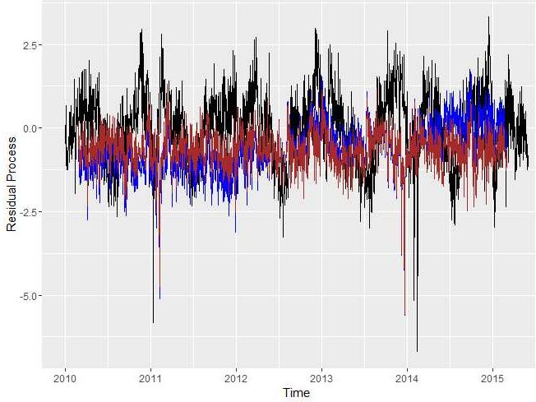
Residual Process

Slide 5
Residual Process: ACF
## Compare Auto-correlation plots
acf(resid.1,lag.max=12*4,main="")
acf(resid.2,lag.max=12*4,main="",col="blue")
acf(resid.3,lag.max=12*4,main="",col="brown")

Slide 6
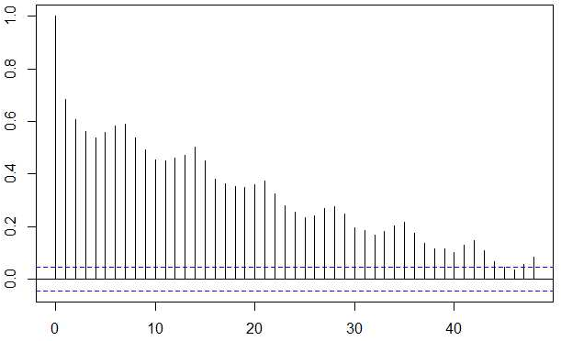
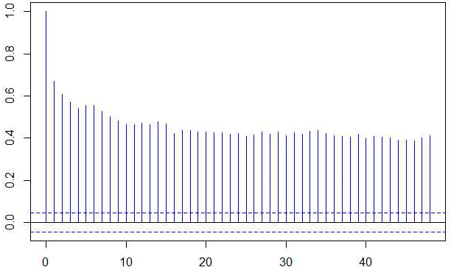
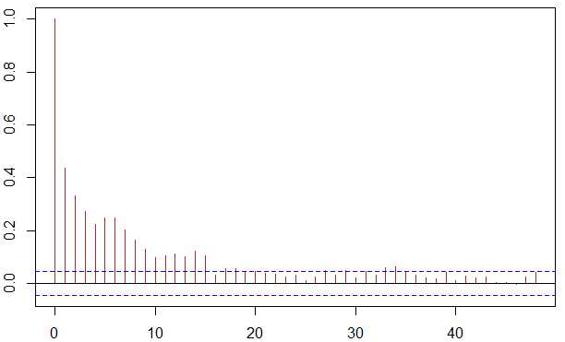
Residual Process: ACF
ACF is outside of the band for the first 15 lags, an indication of stationarity

Slide 7
Findings
There is a significant increasing trend in the Emergency Department (ED) patient volume over the past five years
Seasonality is more complex; both monthly and day-of-the-week are statistically significant seasonality
There are cyclical patterns that may not be fully captured by seasonality; other cyclical factors such as flu season or school season may explain the cyclical pattern

Slide 8
Summary

